Slide 1
An italian ‘anti-dictionary’
Towards a representation of a XIXth century lexicographic reflection

Slide 2
The Proposta
The Proposta di alcune correzioni ed aggiunte al Vocabolario della Crusca (1817-1826) is the main XIXth century Italian contribution to lexicographic, rhetoric and linguistic theory, written by an équipe led by the renowned poet Vincenzo Monti.

Slide 3
Vincenzo Monti

Slide 4
Anti-Crusca
It is also the hugest critic voice to the national lexicographic main institution, the Accademia della Crusca.
Crusca ‘veronese’ (1806-1811)
‘puristic’ ideal

Slide 5
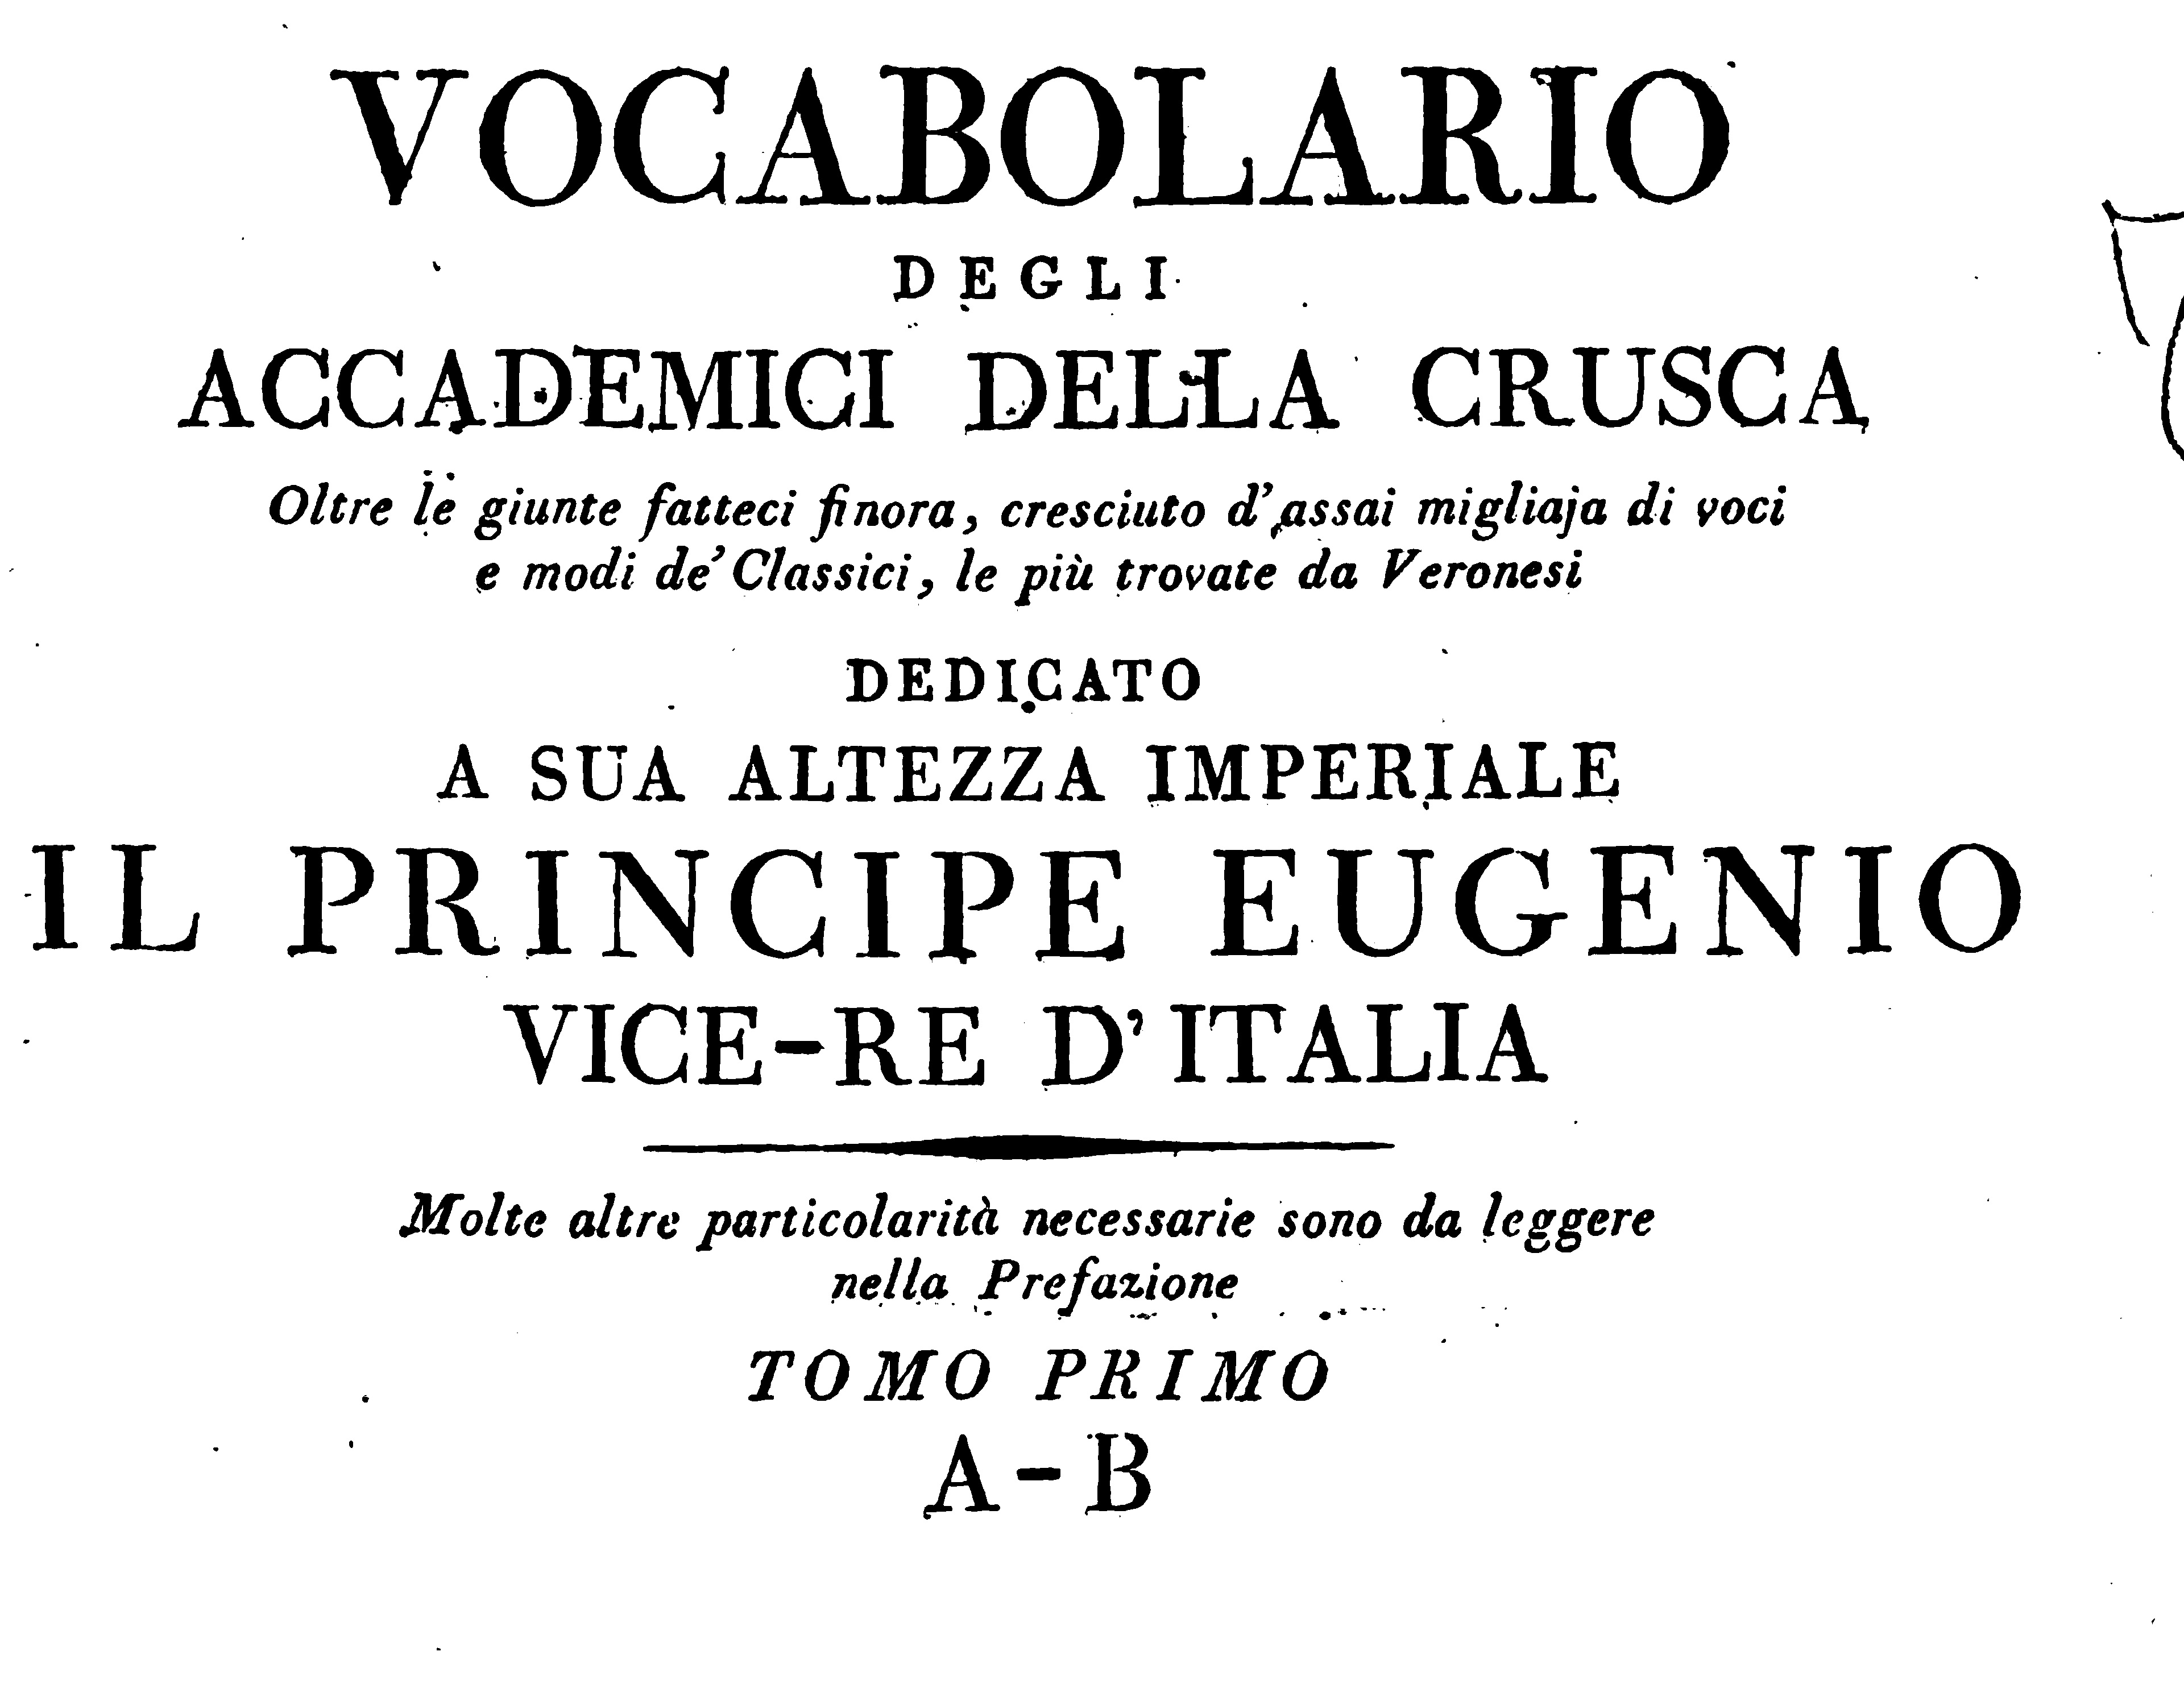
The Crusca ‘veronese’

Slide 6
The organisation of the book
The Proposta is organised alphabetically, discussing the old entries of the Crusca and proposing new entries
A modern and national idea of the language.

Slide 7
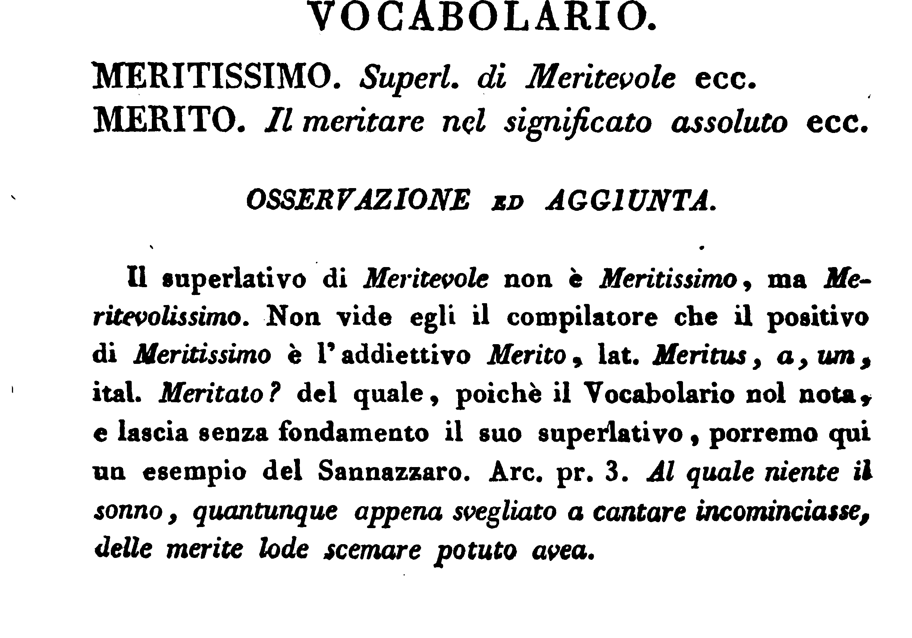
An entry (III/2, p. 22)

Slide 8
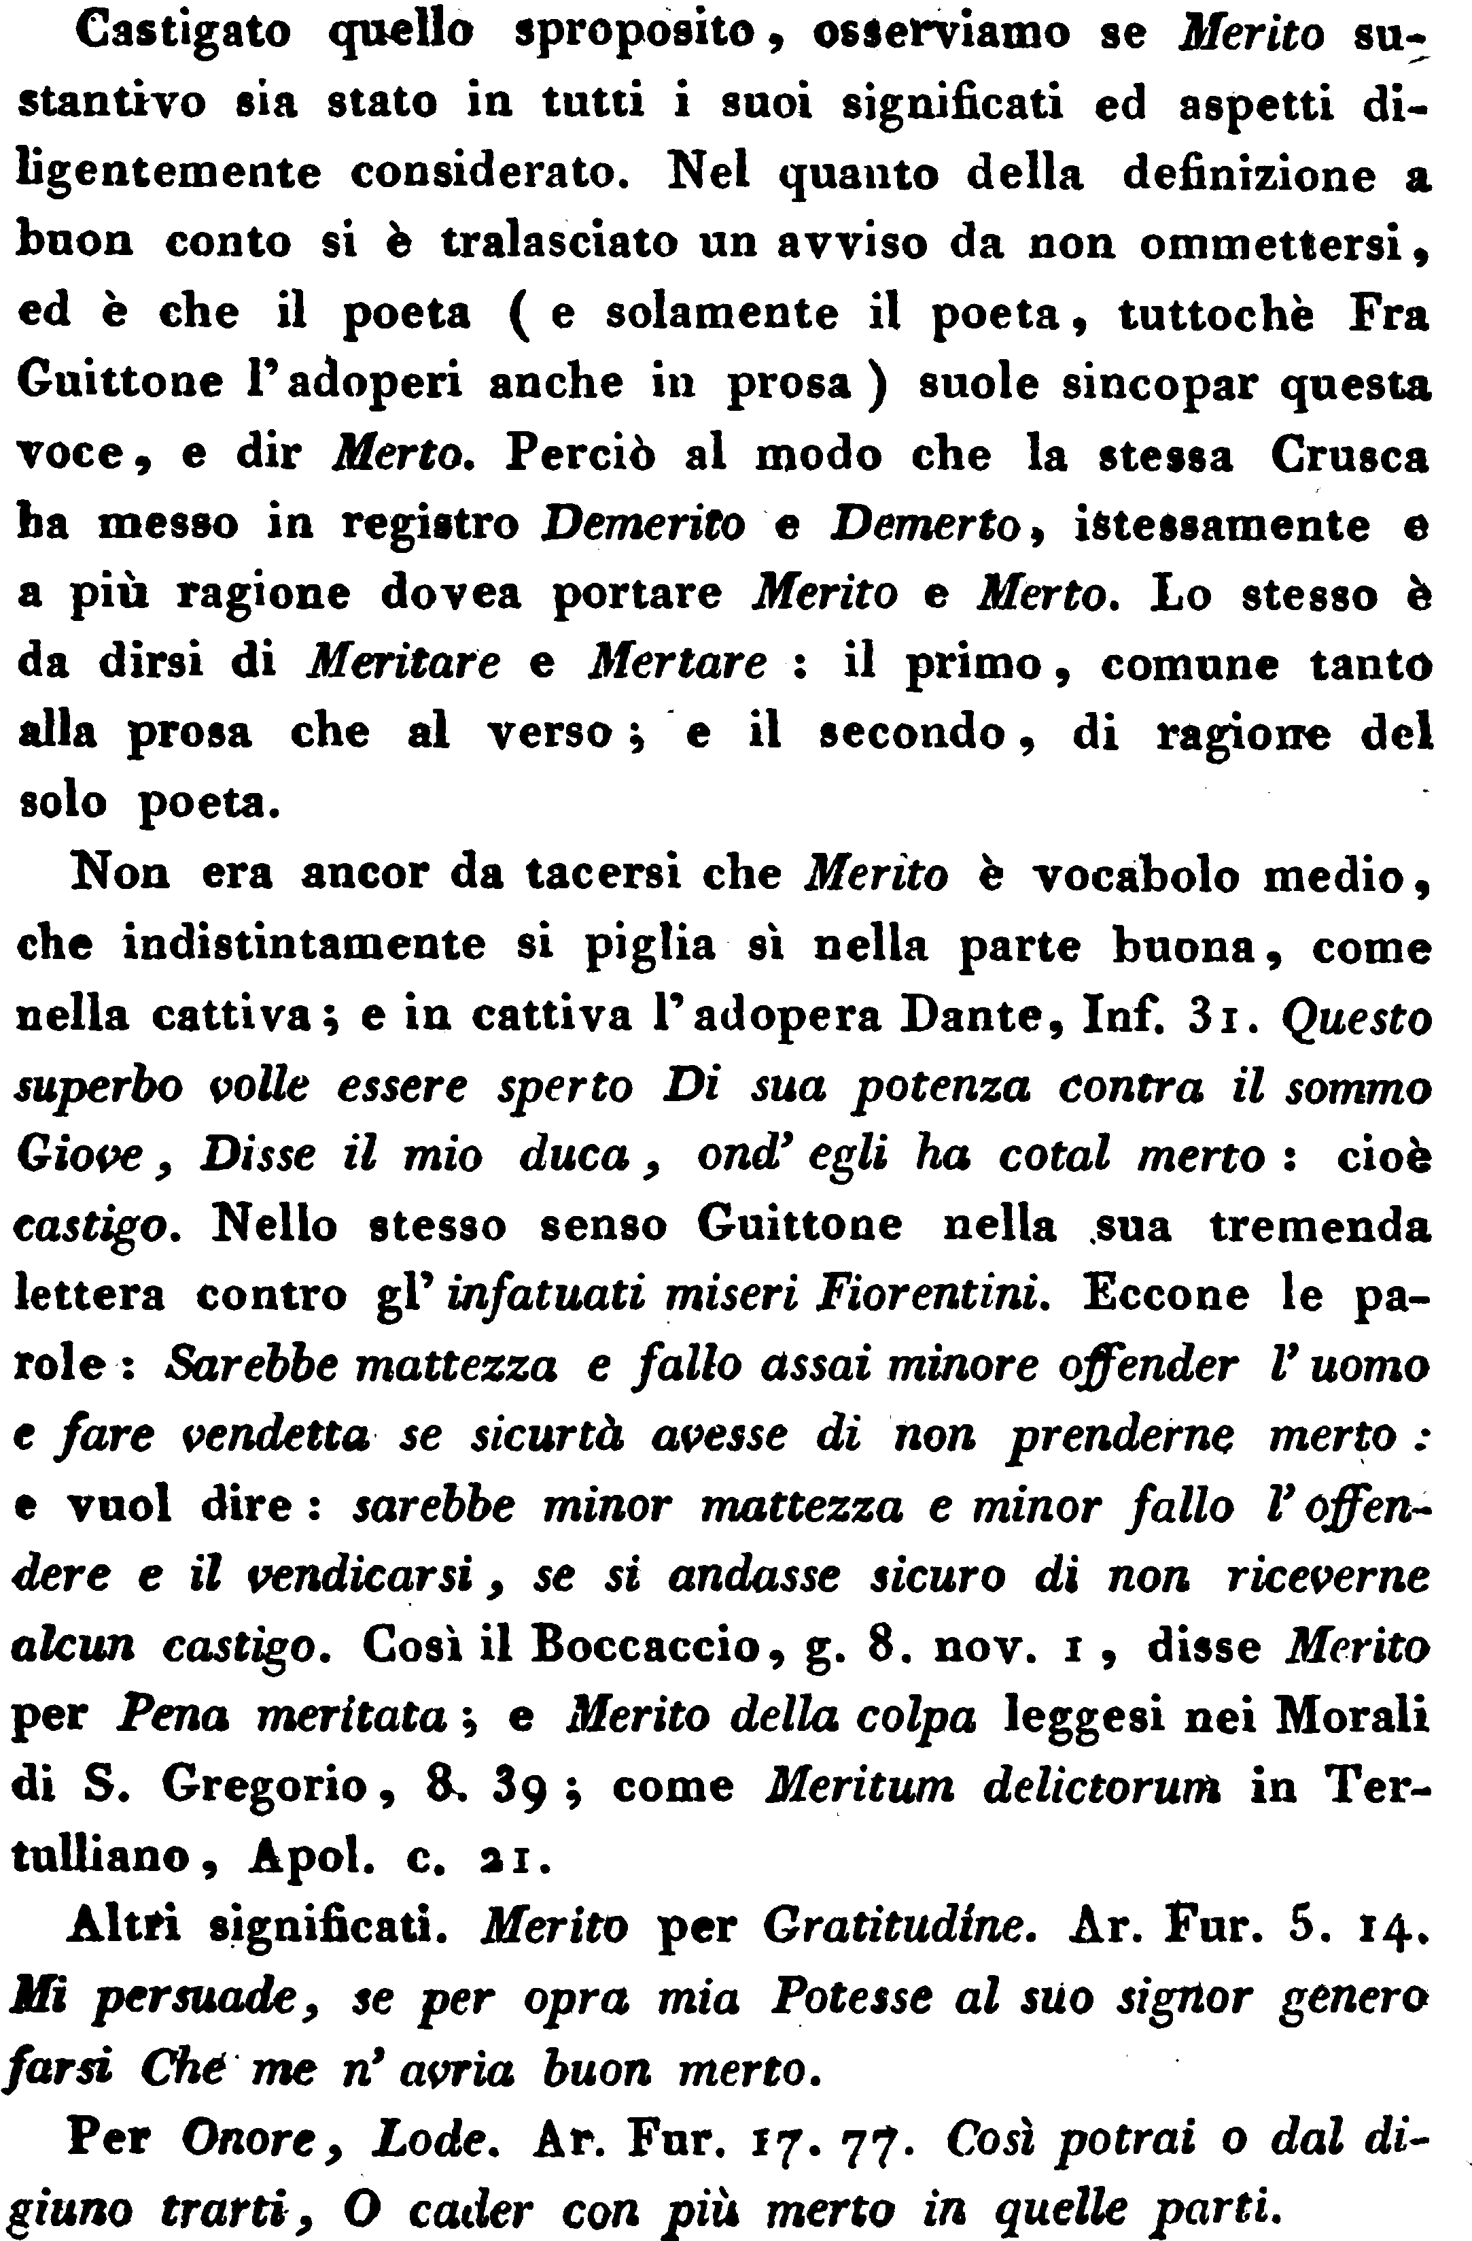
III/2, p. 23

Slide 9
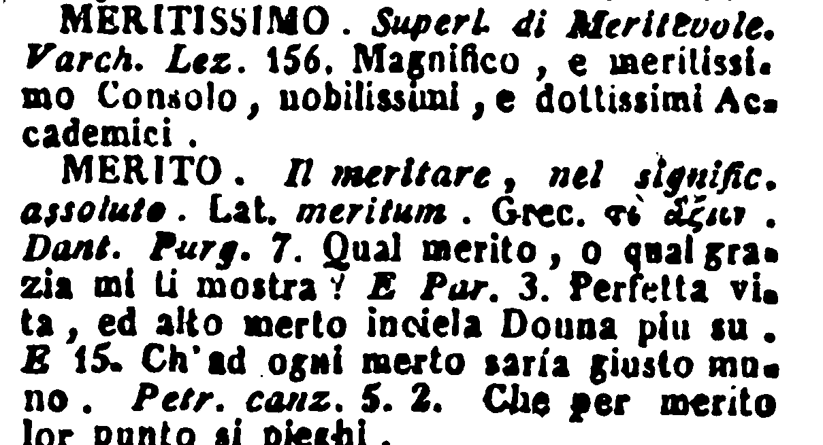
The criticized entry

Slide 10
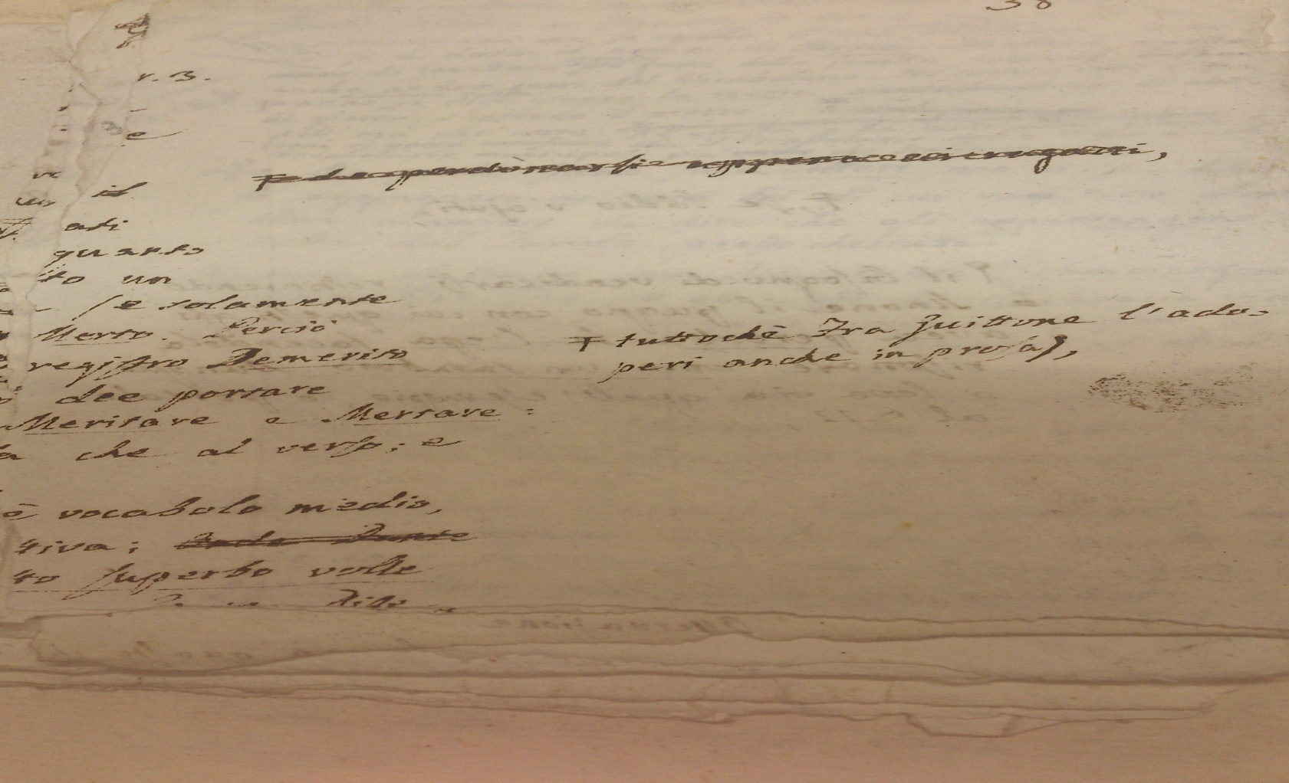
The manuscript

Slide 11
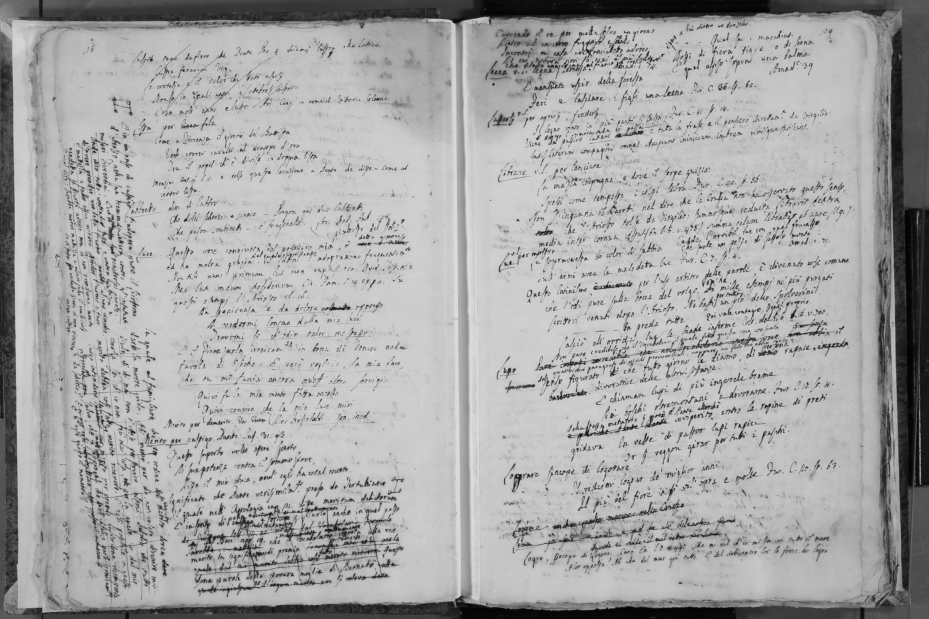
The ‘avantext’: a prototype of dictionary

Slide 12
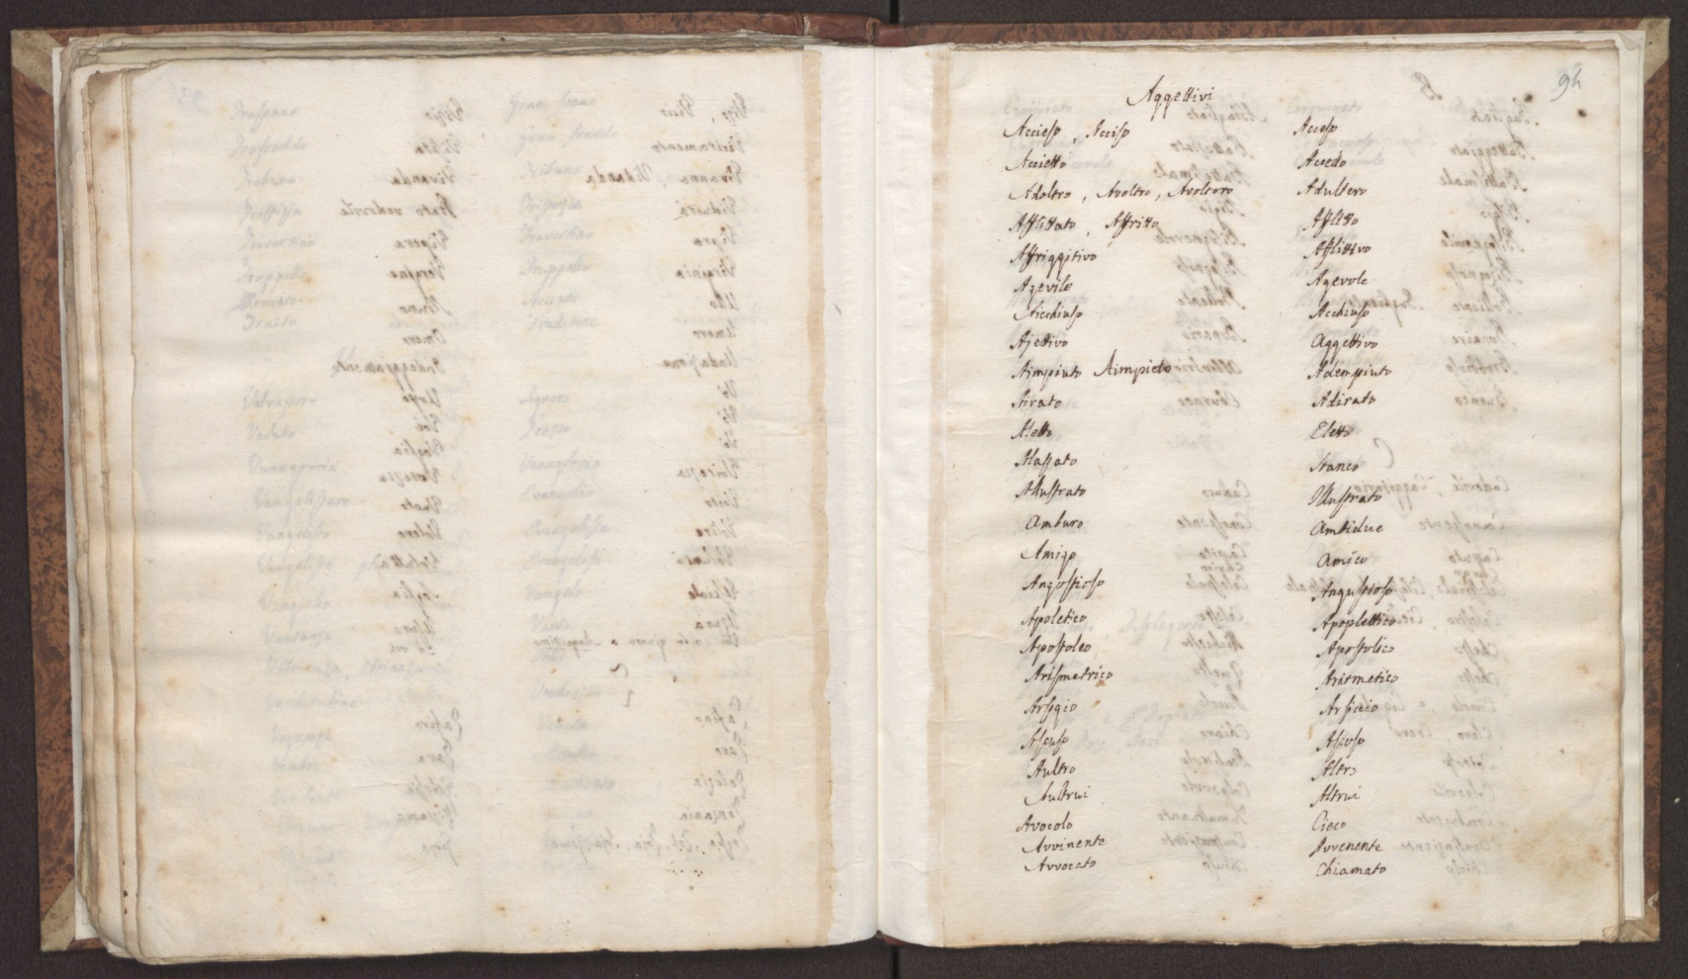
The dictionary of the ‘dead words’

Slide 13
A digital edition
Being able to digitally manage, retrieve and compare all these lexicographic data it is an incredible chance to make this work readable again, since it has not a modern paper edition.

Slide 14
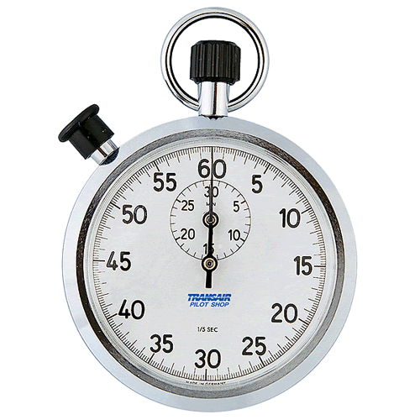
Time’s Up!
Thank you!
Claudia Bonsi
University of Milan-Bicocca
https://unimib.academia.edu/ClaudiaBonsi
Bio: Phd at Sapienza University of Rome,
Post-doc at University of Milan-Bicocca
Department of Humanities for Education
Fields of interest: Italian literature, History of linguistic thought, lexicographie, philology, Italian L2

